Slide 1
DevOps
Project Presentation

Slide 2
2 different source code repositories
Used to separate front-end repository for this project.
Omni food: A web application aims to deliver healthy food at your footsteps
G-stock: Investment websites offer customer support and assistance to their users.

Slide 3
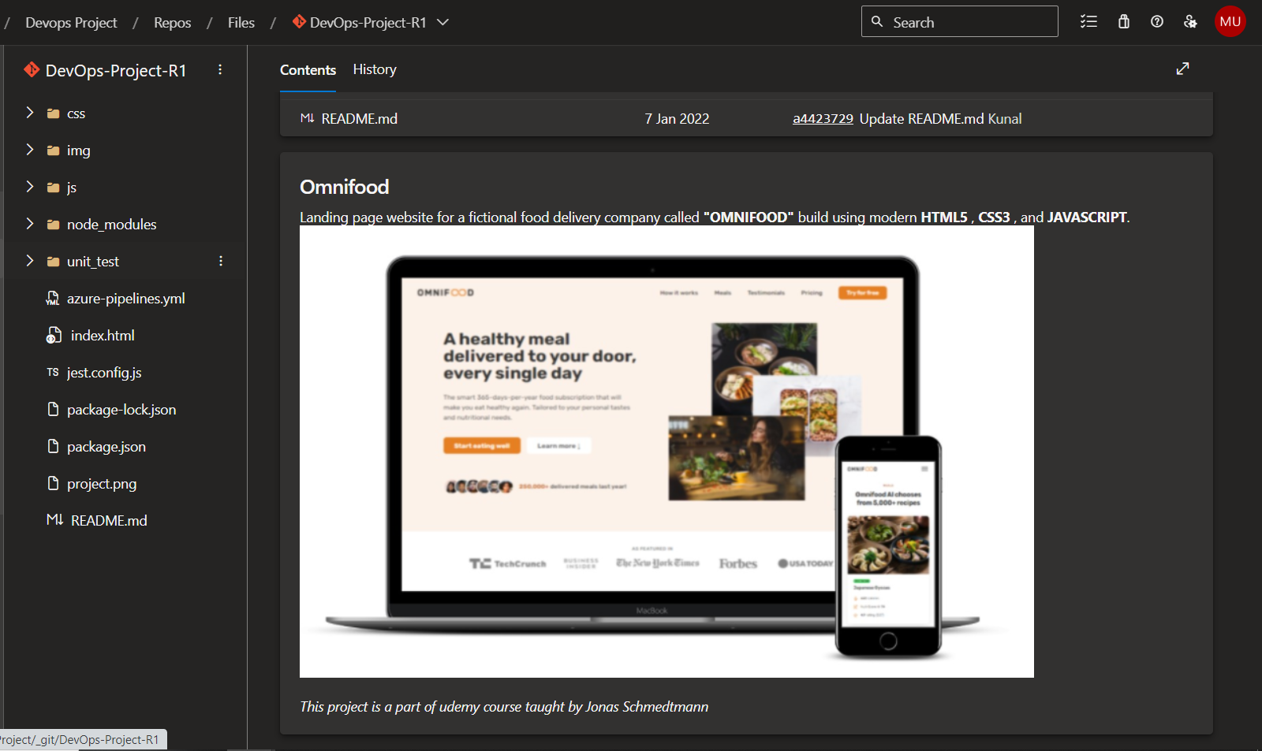
Omni Food

Slide 4
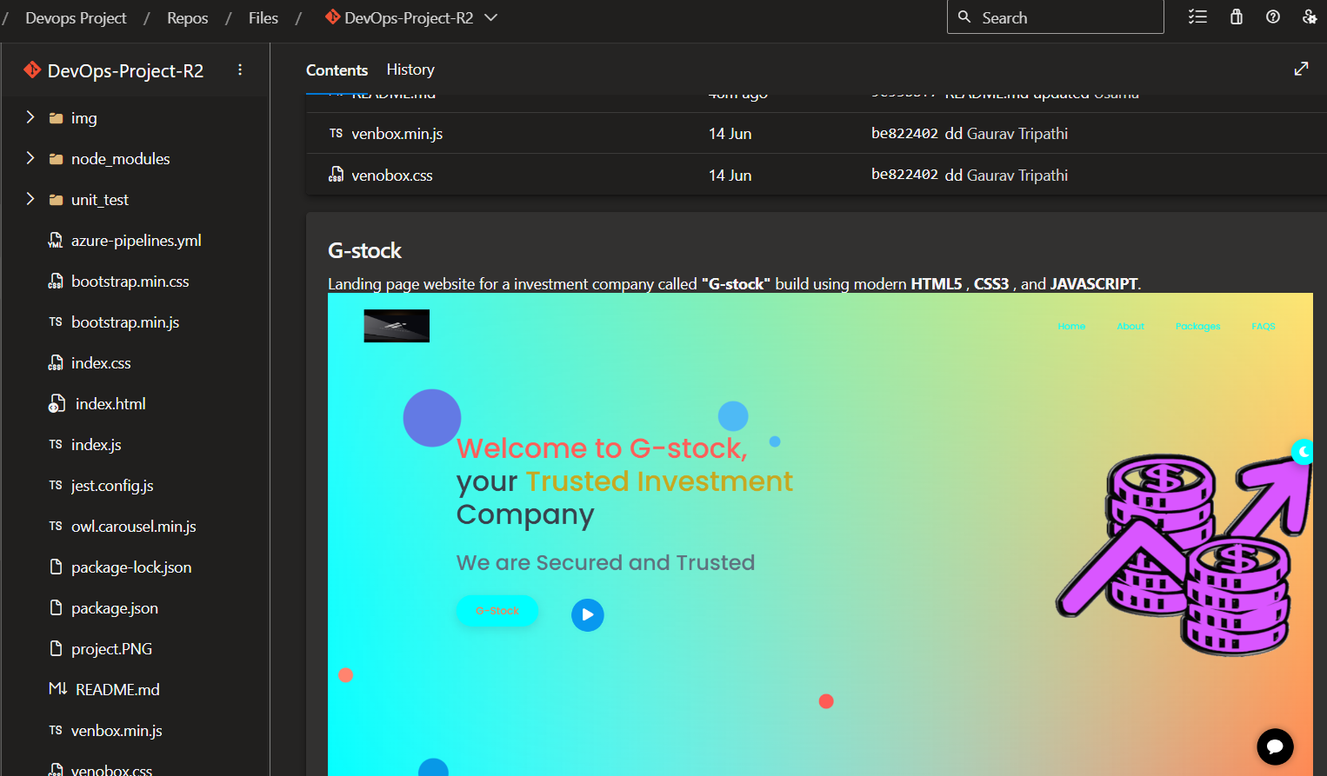
G-stock

Slide 5
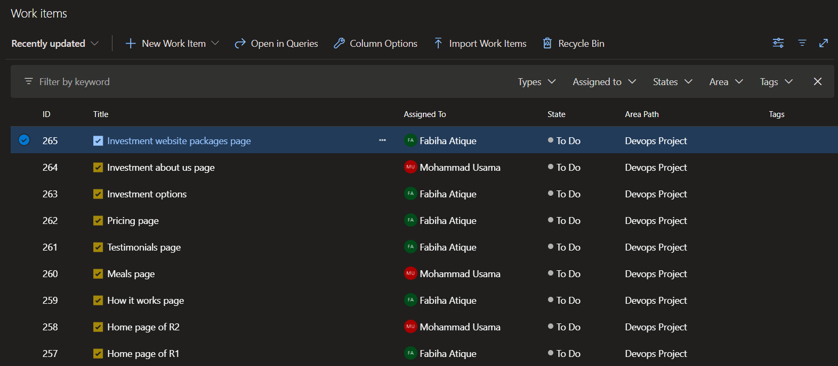
Azure Boards

Slide 6
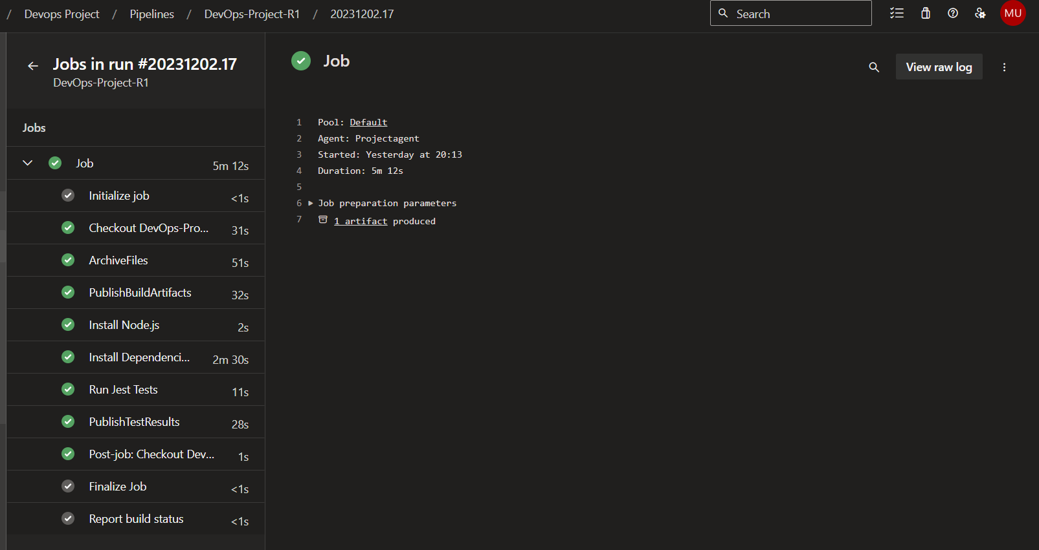
Continuous Integration (CI Pipeline)

Slide 7
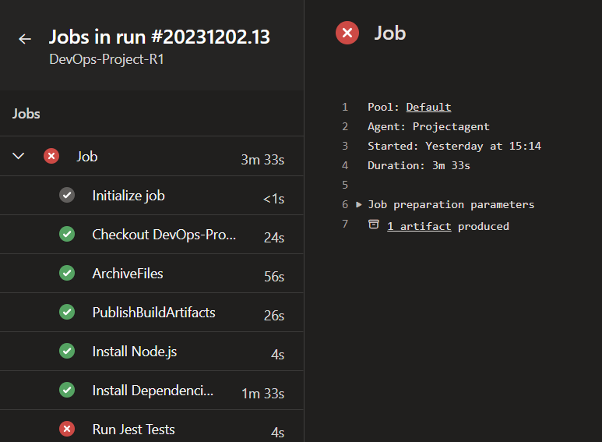
Automated testing
In CI pipeline, it will automatically runs the test cases, failing to pass test cases will result in build failed.
Below is the example of forcely failing test case

Slide 8
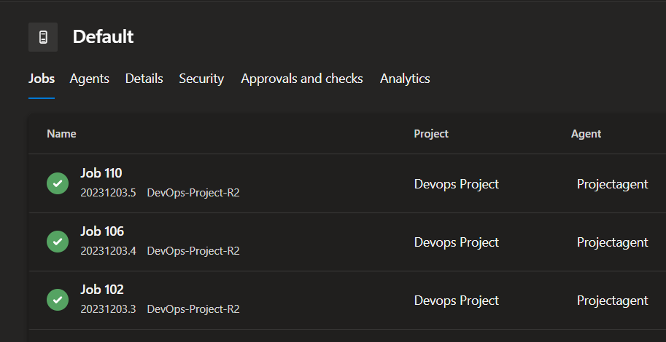
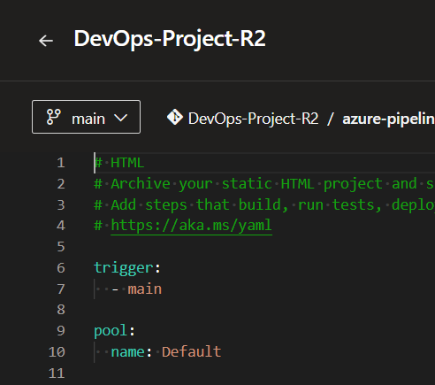
Self hosted Agent

Slide 9
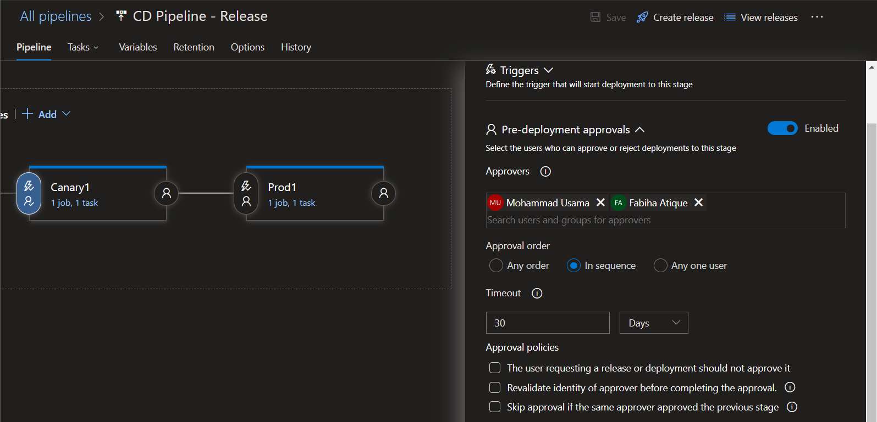
Pre-deployment approvals

Slide 10
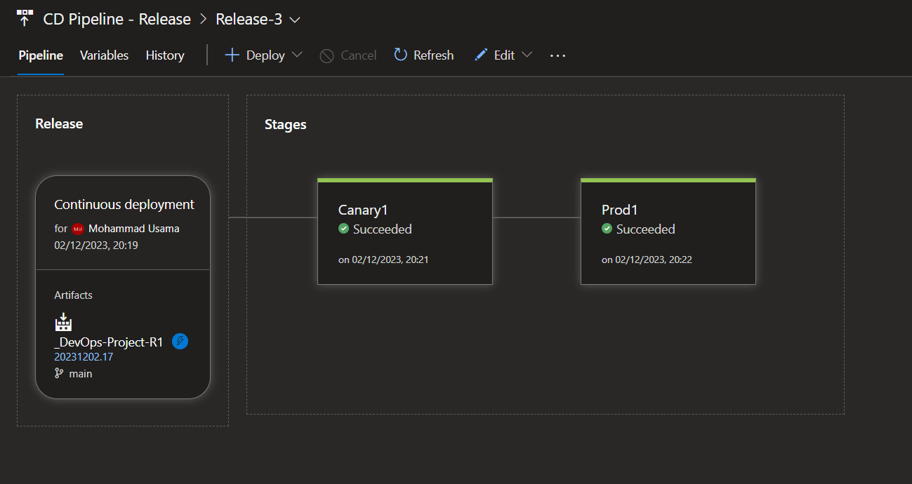
CD Pipeline - Release

Slide 11
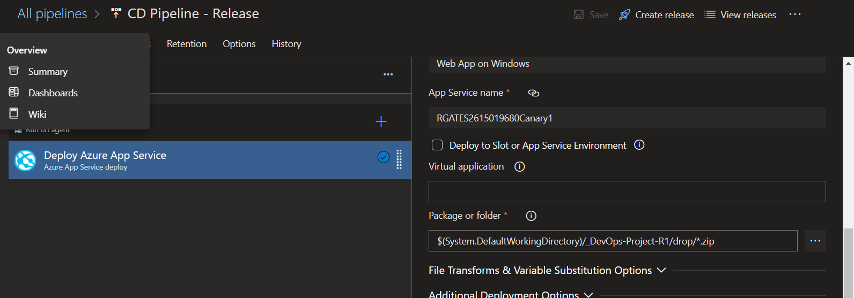
Picking artifacts created after CI build

Slide 12
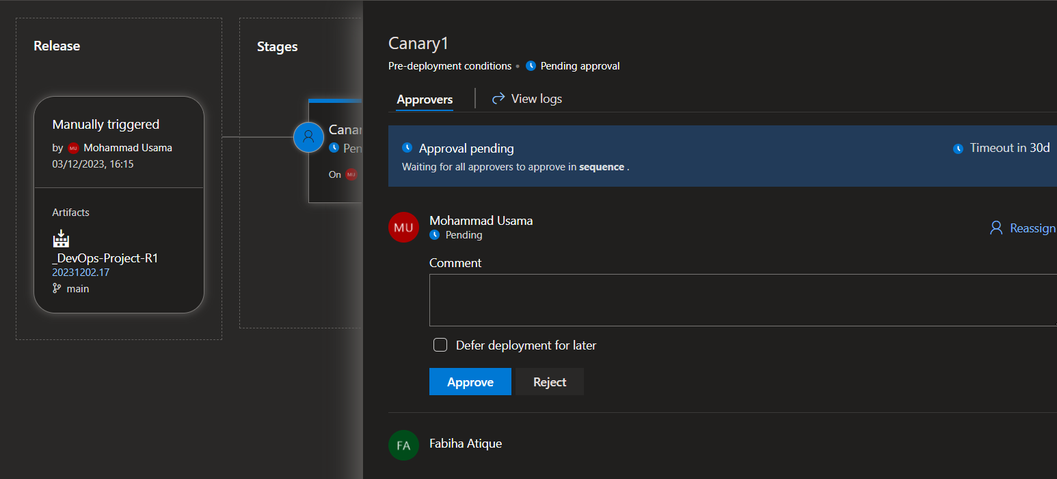
Require approval which we added in previous steps

Slide 13
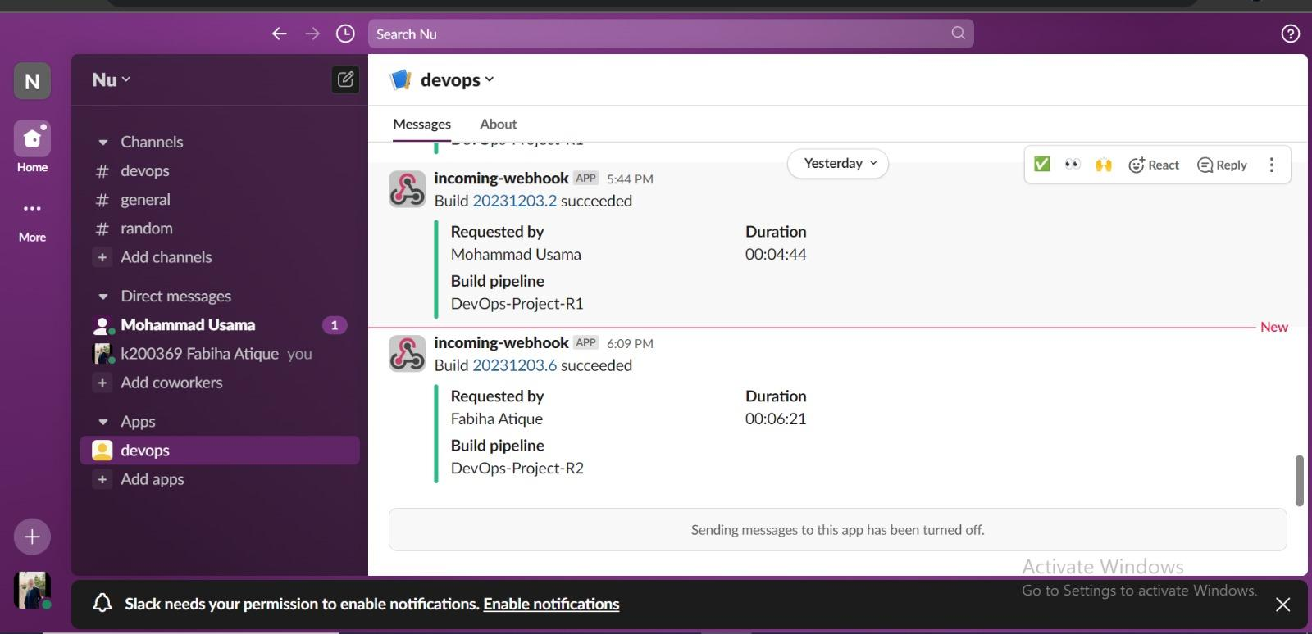
Slack Integration
Now I have created pipeline
and it notified me on
Slack.

Slide 14
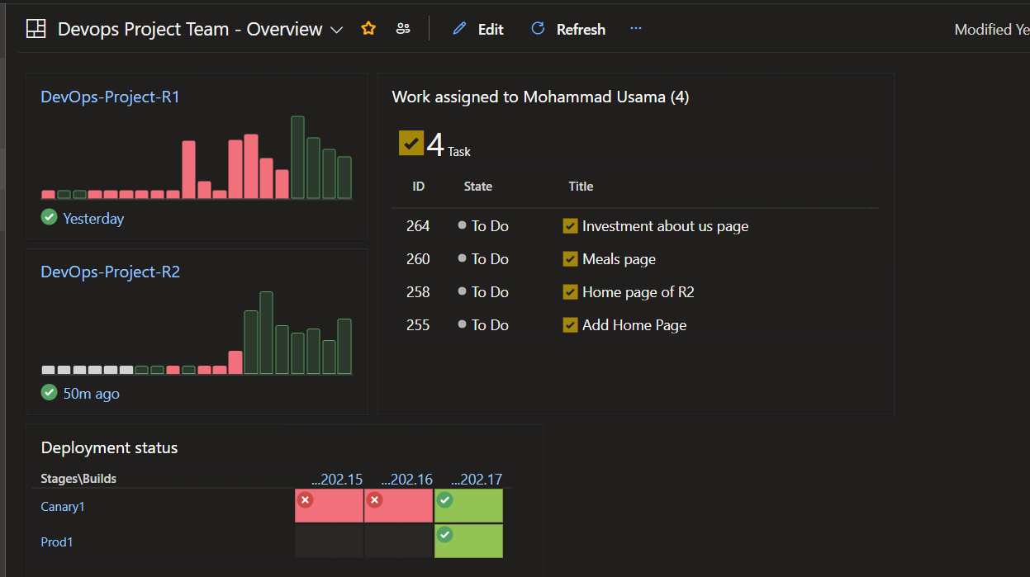
Azure DevOps Dashboard

Slide 15
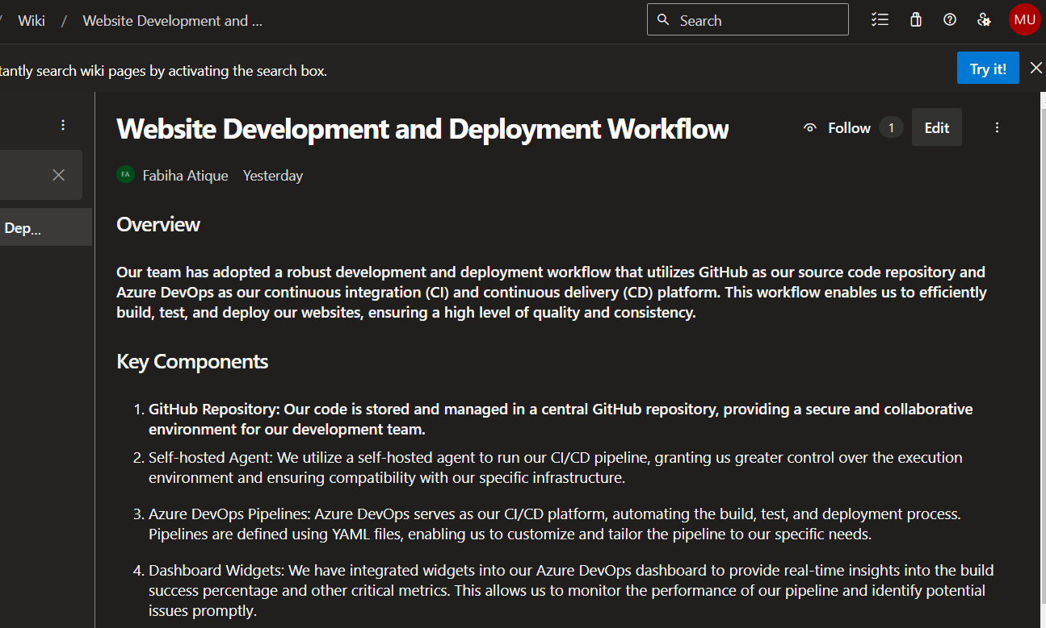
Wiki (Release Notes)

Slide 16
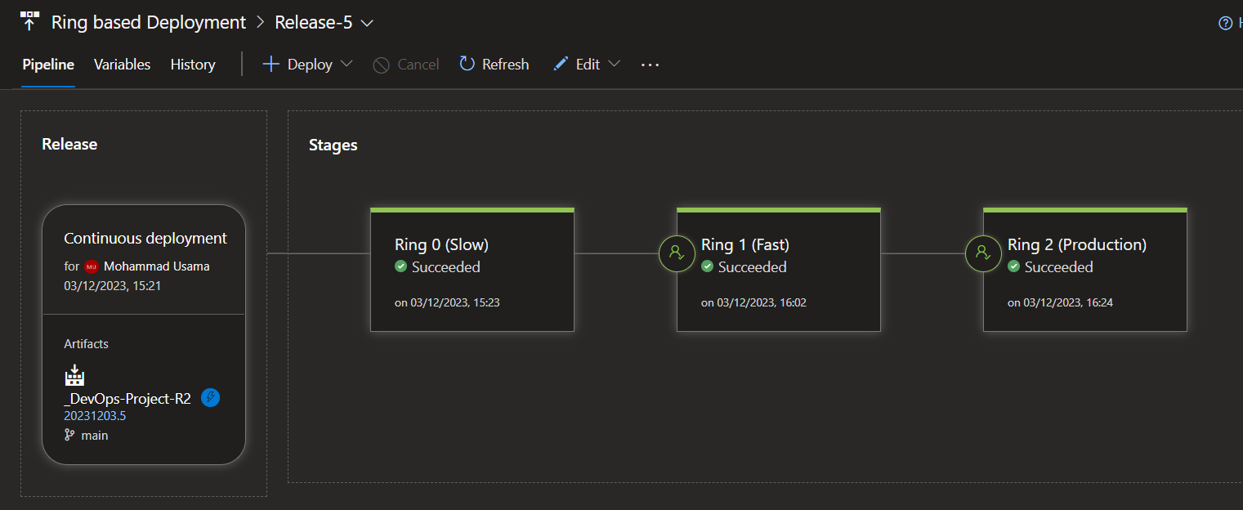
Deployment Strategy: Deployment Rings

Slide 17
THANK YOU

